Slide 1

Real-Time Greenhouse Monitoring and Automation
Dhanasri G -22ECR041
Dhanusha R -22ECR042
Dhanushkumaran R-22ECR043

Slide 2
Problem Statement: Greenhouse environments require continuous monitoring and precise control of temperature, humidity, and soil conditions to optimize plant growth and prevent resource wastage
Solution:
An automated greenhouse monitoring and control system can be developed using sensors and PIC16F877A to continuously measure and adjust environmental parameters like temperature, humidity, light, and soil moisture. This system would autonomously regulate the greenhouse conditions by controlling ventilation, irrigation, and lighting, ensuring optimal plant growth with minimal human intervention.

Slide 3
Methodology:
Install sensors such as DHT22(temperature and humidity), LDR (light intensity) and Capacitive Soil Moisture.
Gather data continuously from the sensors.
Use a PIC16F877A to process the data and compare it with desired conditions.
Automatically adjust ventilation, irrigation, and lighting based on the sensor data.
Continuously monitor the environment to maintain ideal conditions.
Display data locally.

Slide 4
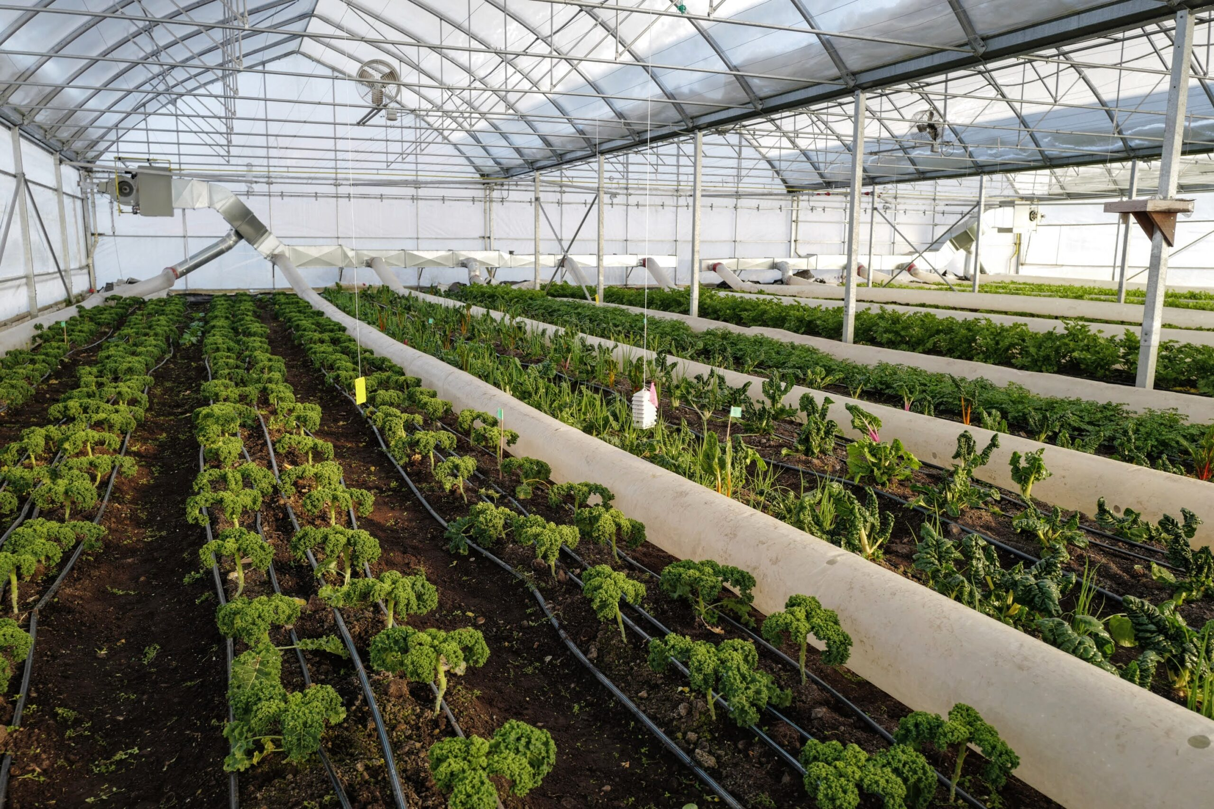
Flow chart
sensor
microcontroller
Ventilation
Irrigation
lighting

